Slide 1
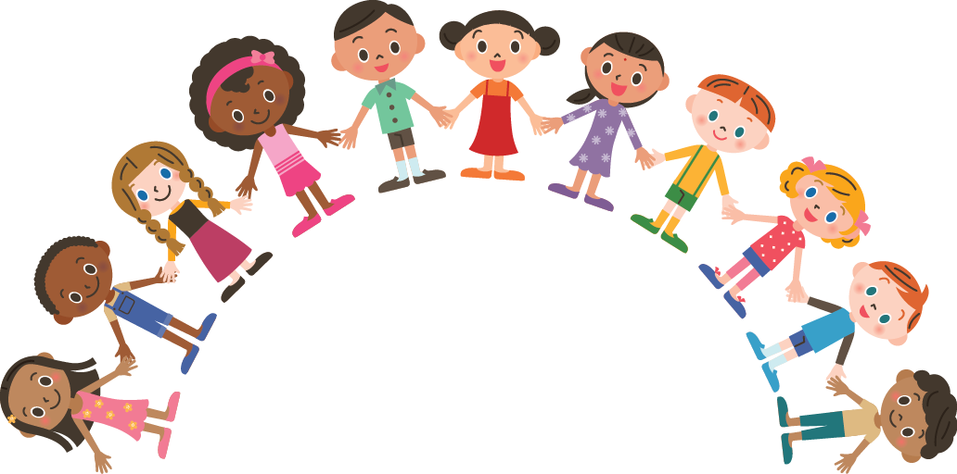
Unit 5: CAN YOU SWIM?
Lesson 2

Slide 2


New words

Slide 3

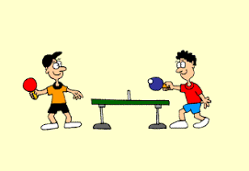
play table tennis

Slide 4
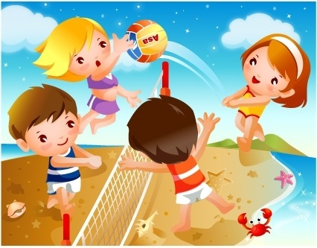
play volleyball

Slide 5
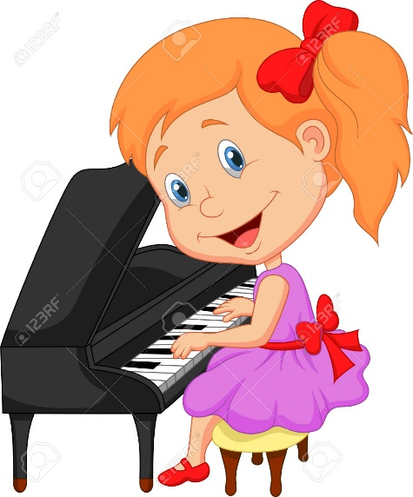
play the piano

Slide 6
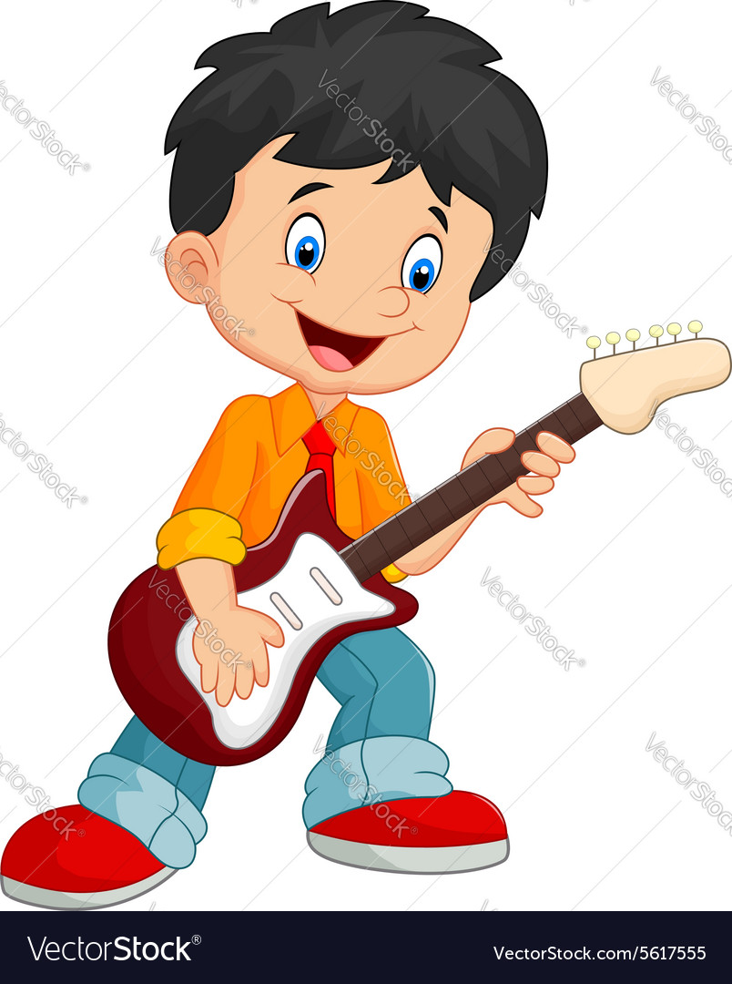
play the guitar

Slide 7


play table tennis
Play volleyball
play the guitar
play the piano

Slide 8
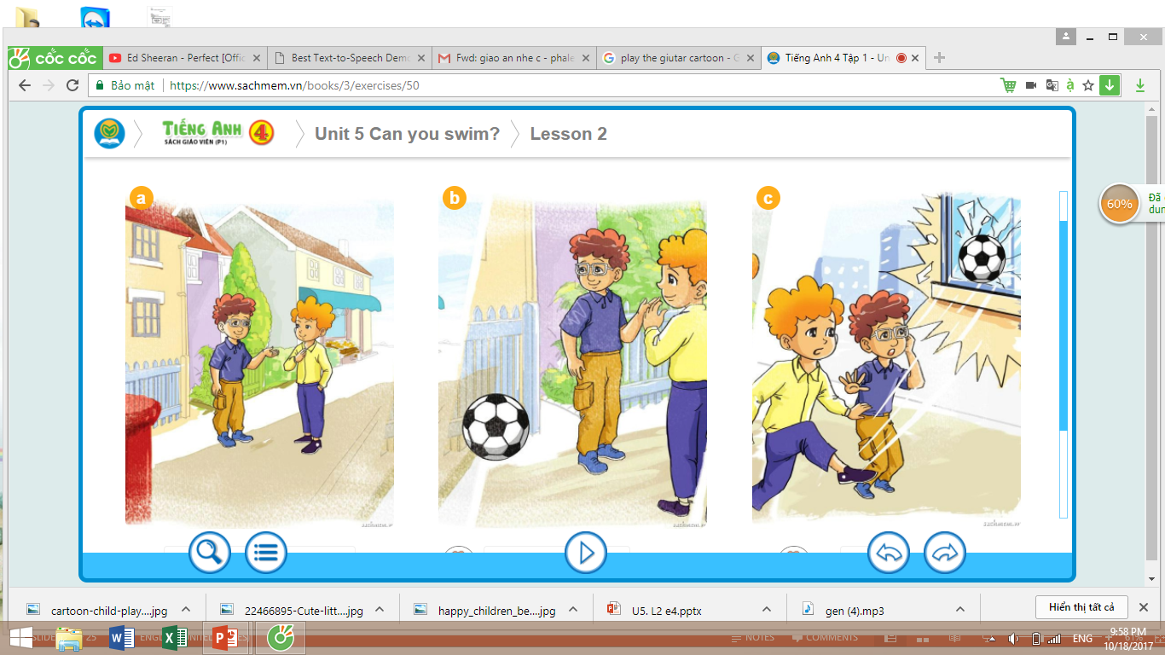
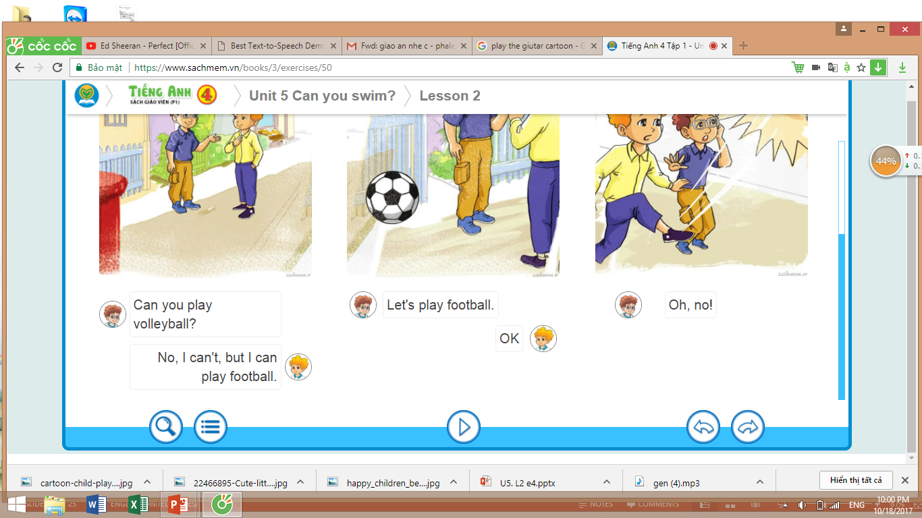
1
Look, listen and repeat

Slide 9




Model sentences
Can you ___________?
☺ Yes, I can
☹ No, I can’t

Slide 10
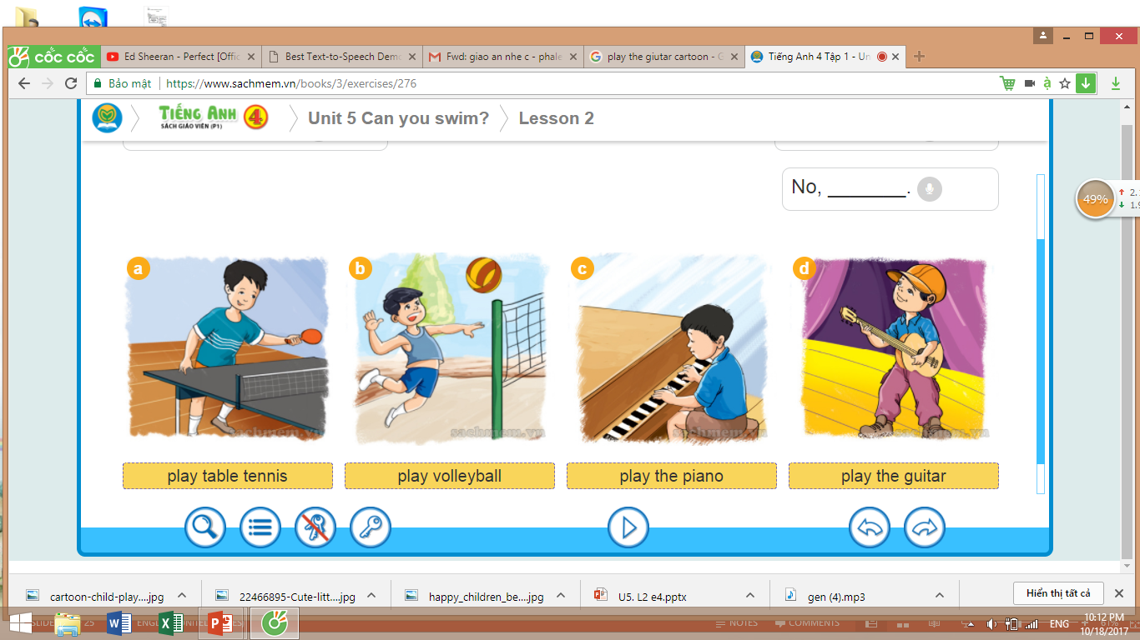
2
Point and say
☺ Yes, I can
Can you ______?
☹ No, I can’t

Slide 11
SURVEY
Actions Name | Swim | Dance | Play table tennis | Play volleyball | Play football | Sing | Other ……
Nam |  |  |  |  |  |  | skip
Phong
Lan

Slide 12
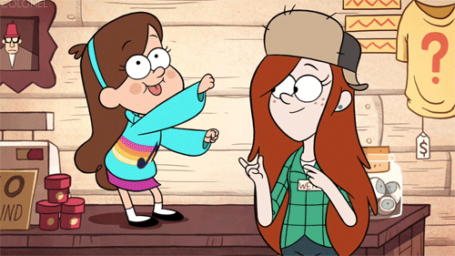
Thank you for joining!

